Slide 1
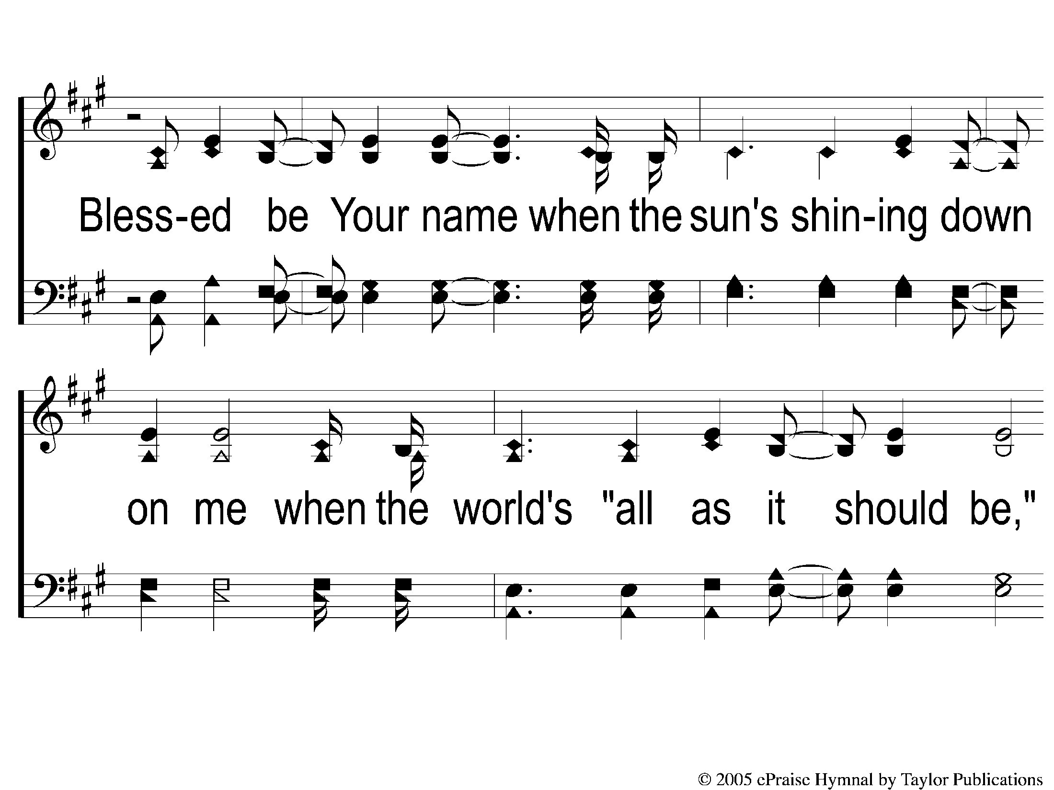
2-1 Blessed Be Your Name
Blessed be Your Name

Slide 2
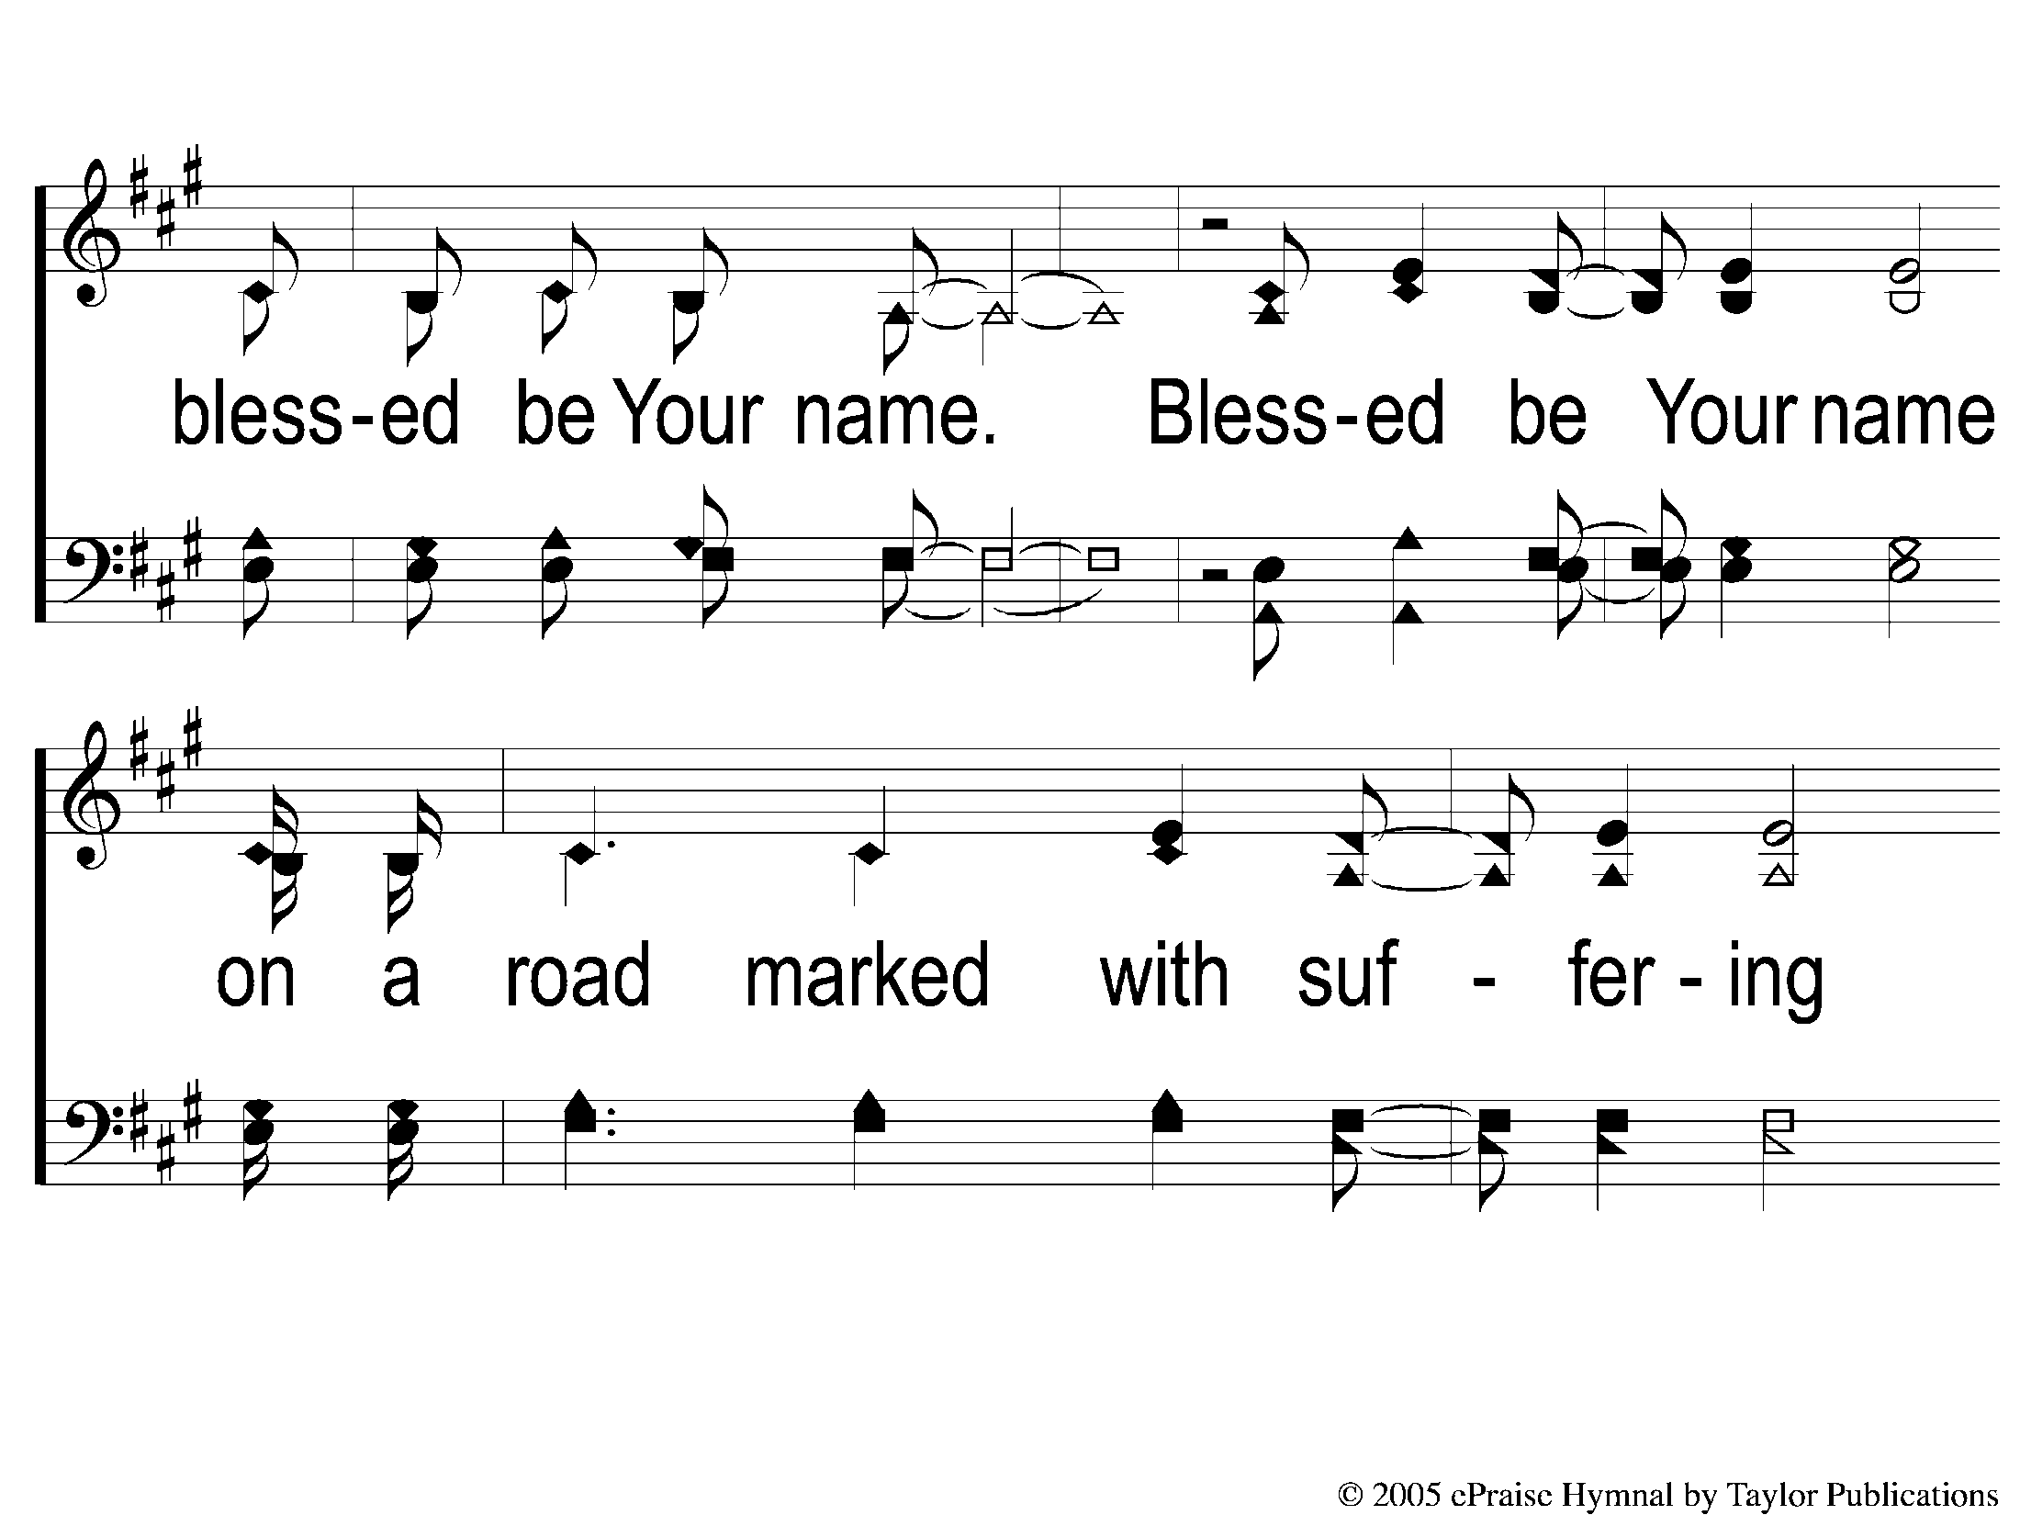
2-2 Blessed Be Your Name
Blessed be Your Name

Slide 3
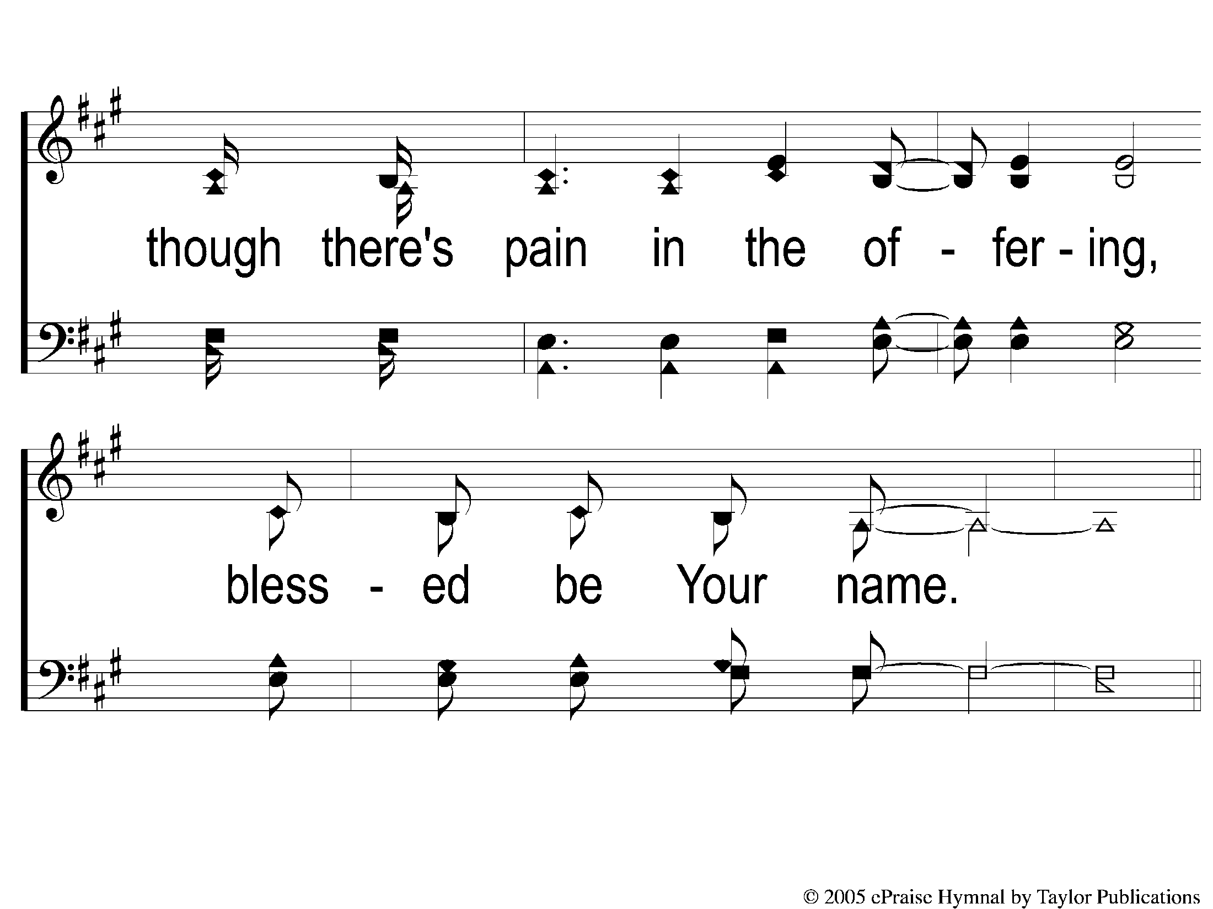
2-3 Blessed Be Your Name
Blessed be Your Name

Slide 4
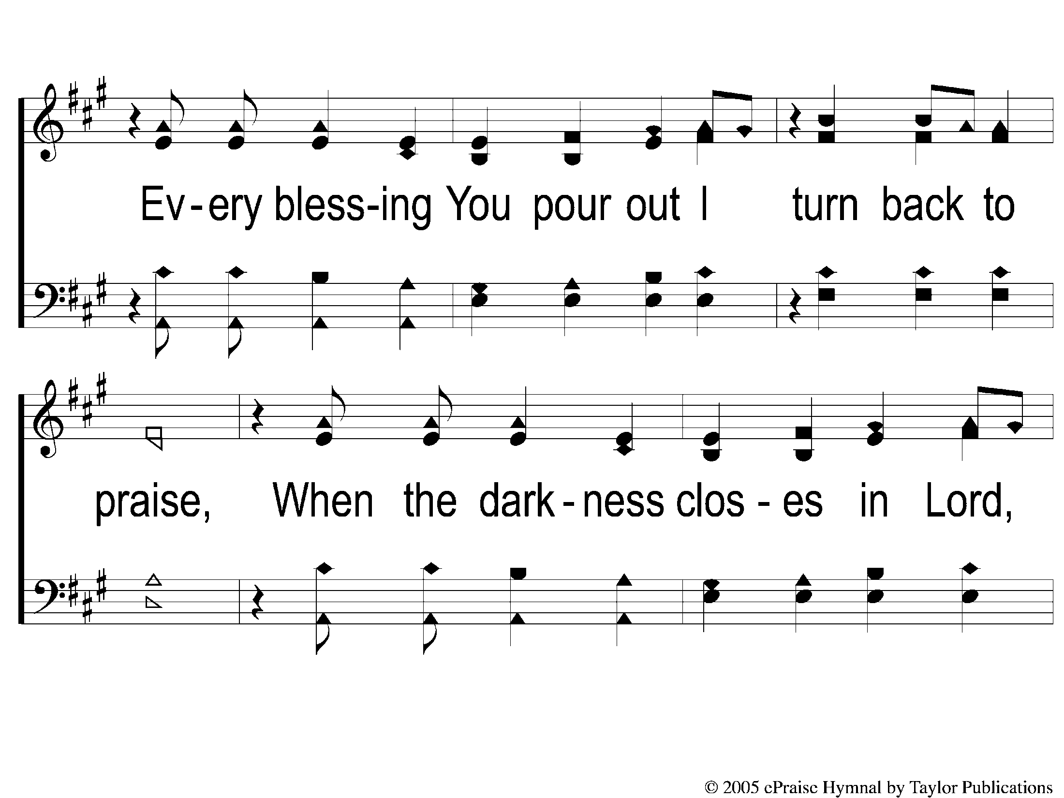
2C-1 Blessed Be Your Name
Blessed be Your Name

Slide 5
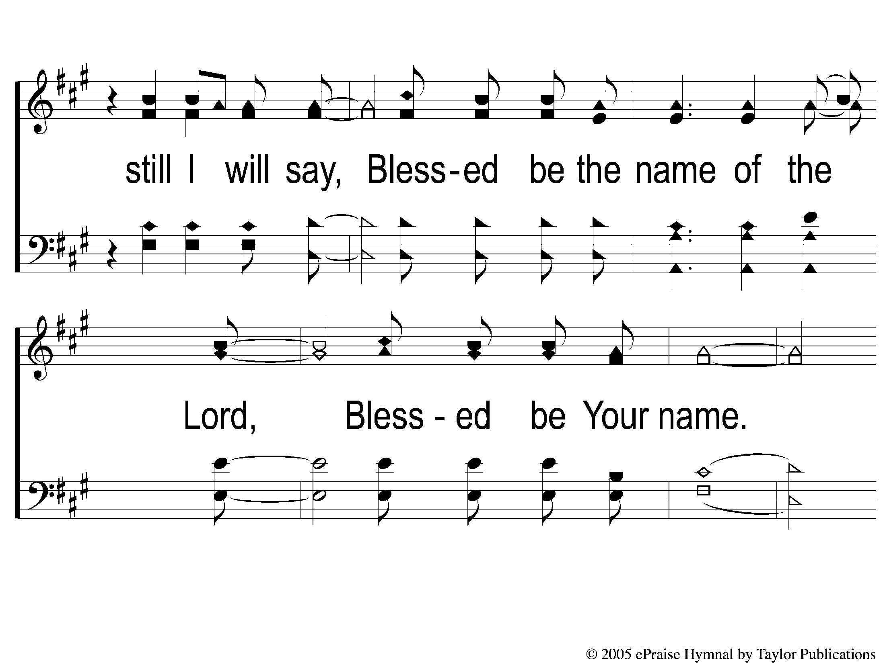
2C-2 Blessed Be Your Name
Blessed be Your Name

Slide 6
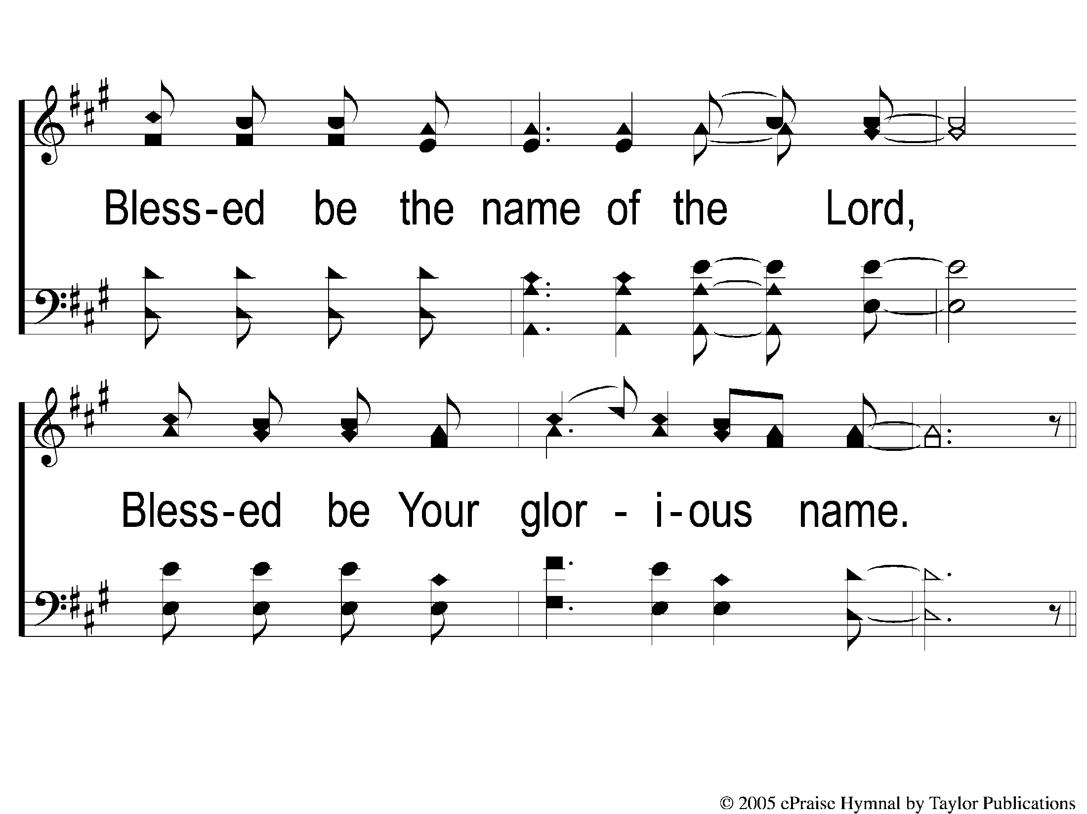
2C-3 Blessed Be Your Name
Blessed be Your Name

Slide 7
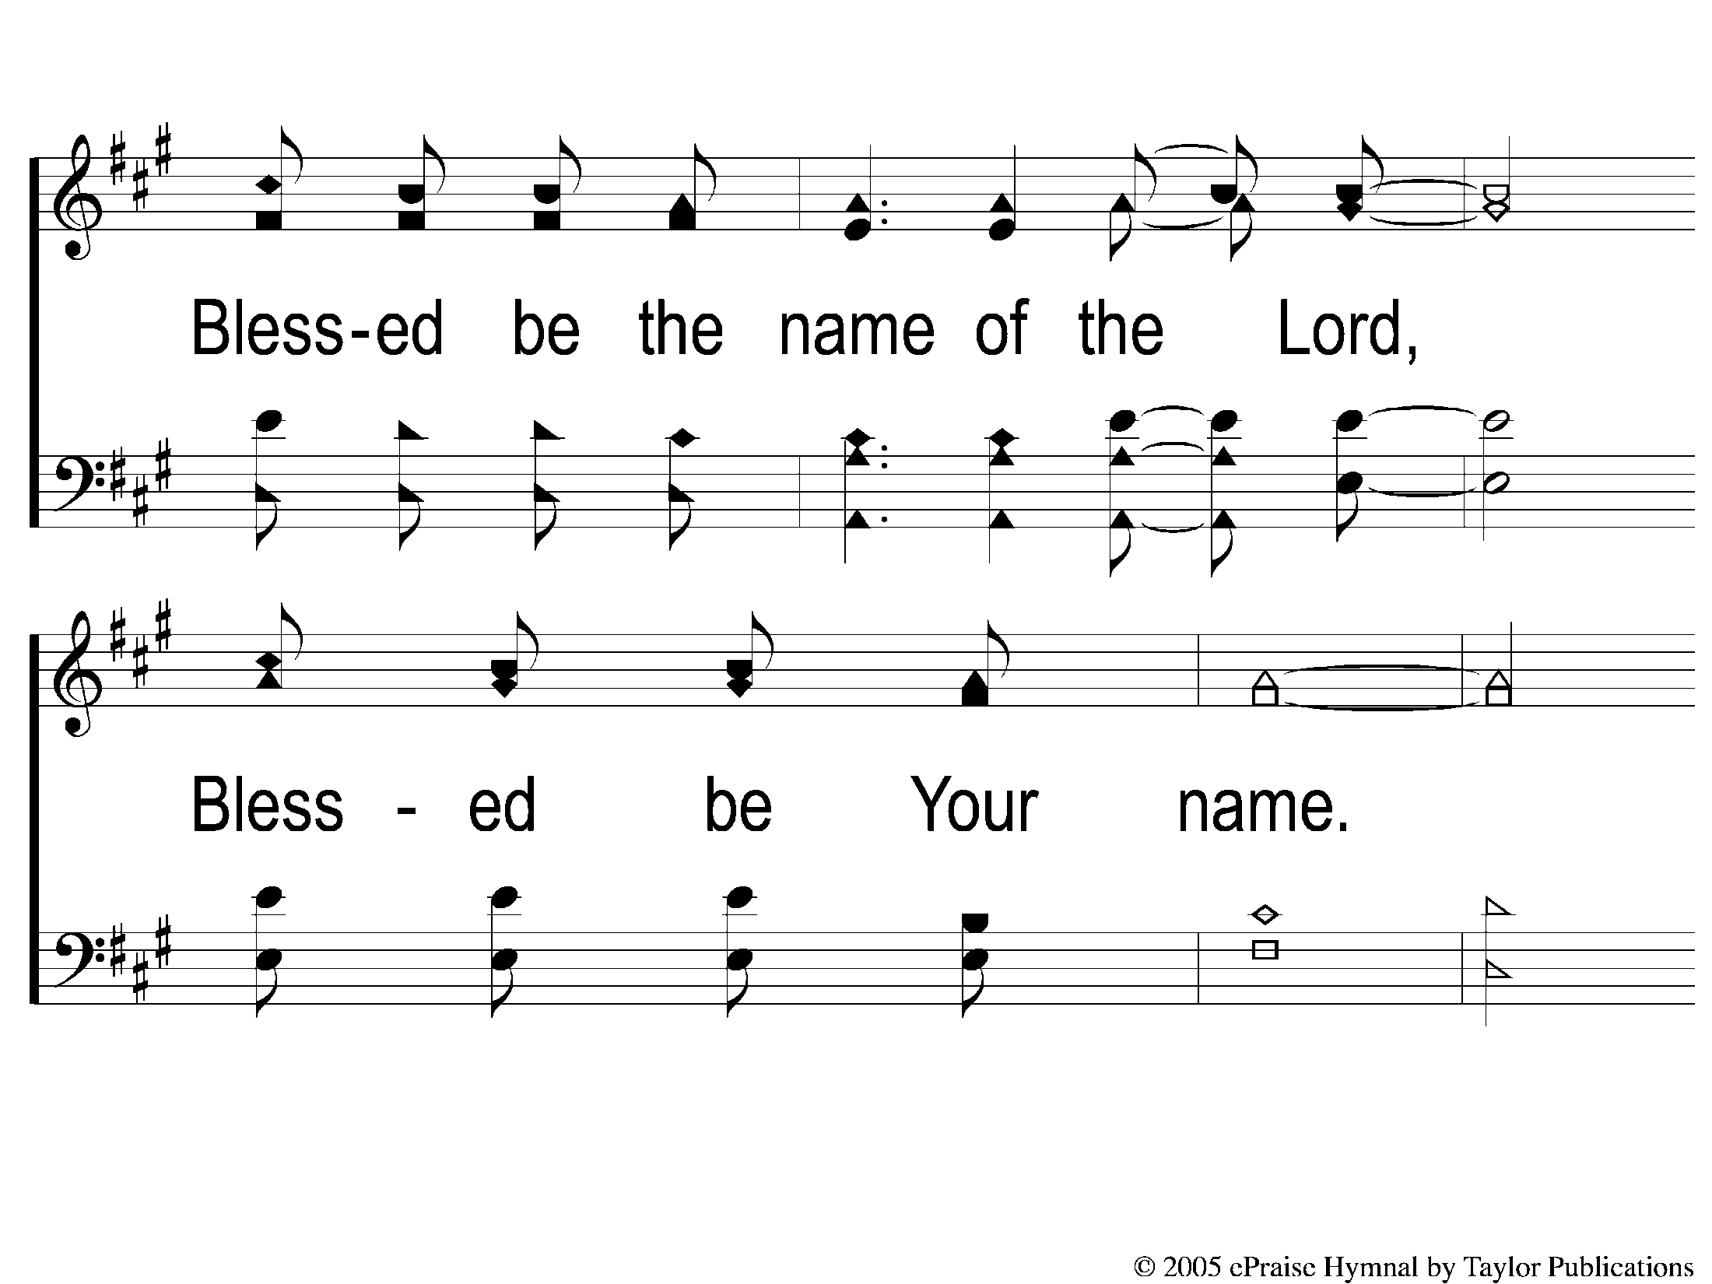
DS1 Blessed Be Your Name
Blessed be Your Name

Slide 8
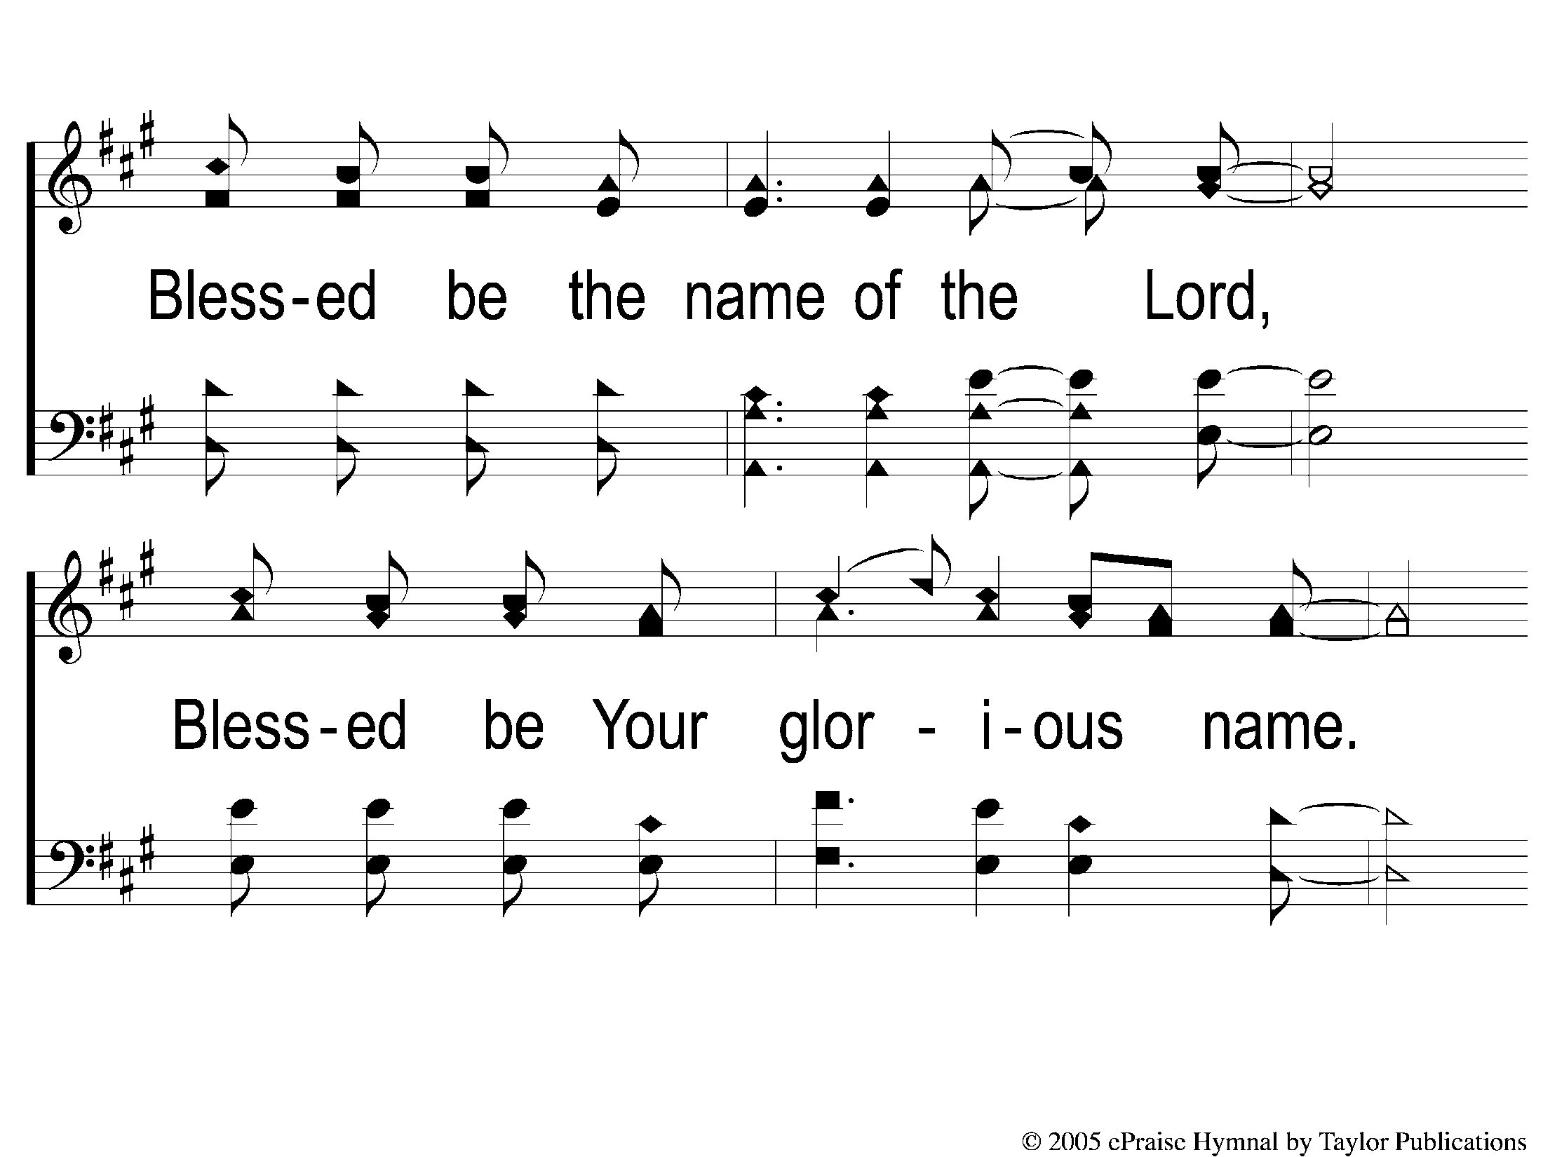
DS2 Blessed Be Your Name
Blessed be Your Name

Slide 9
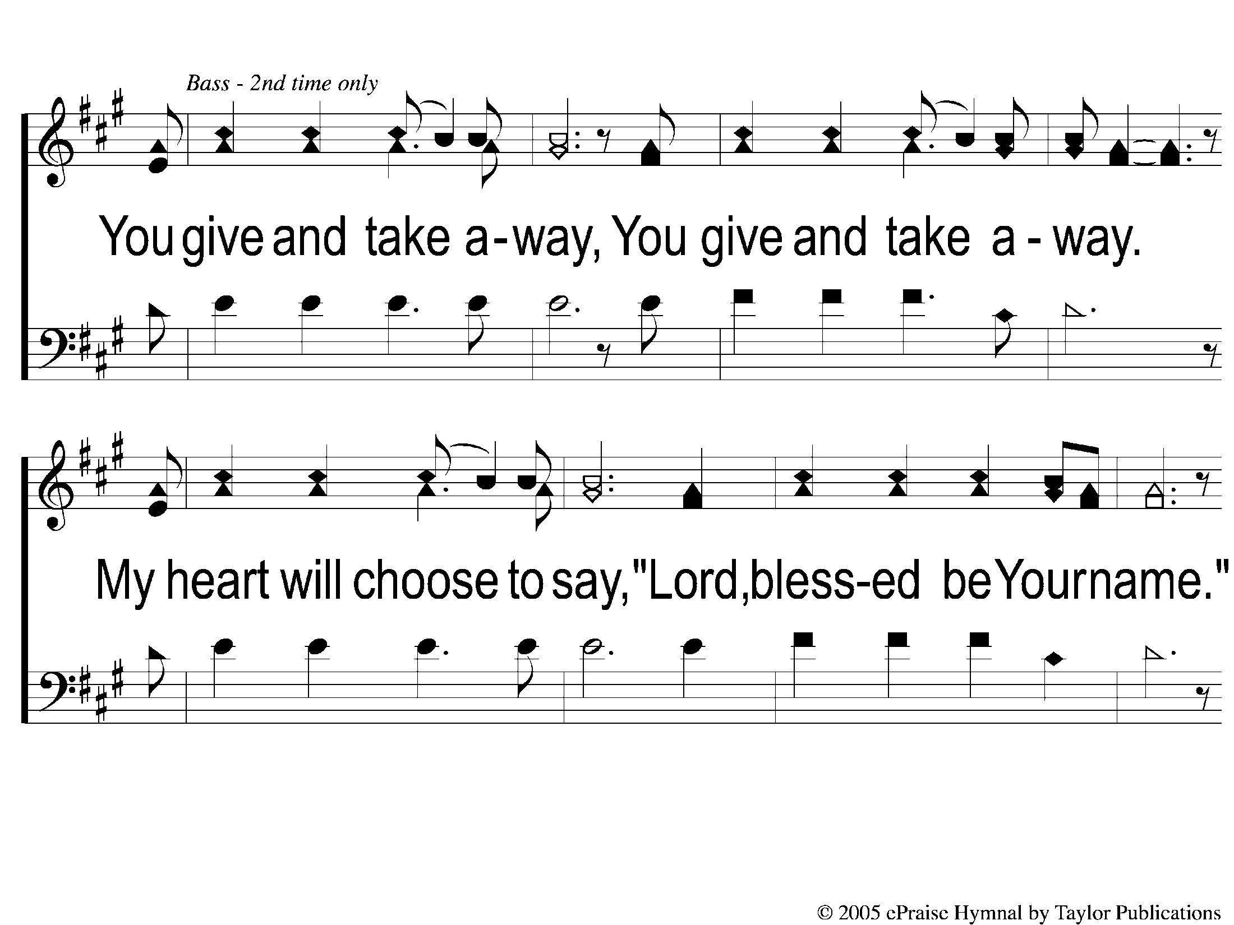
1Bridge1 Trio Blessed Be Your Name
Blessed be Your Name

Slide 10
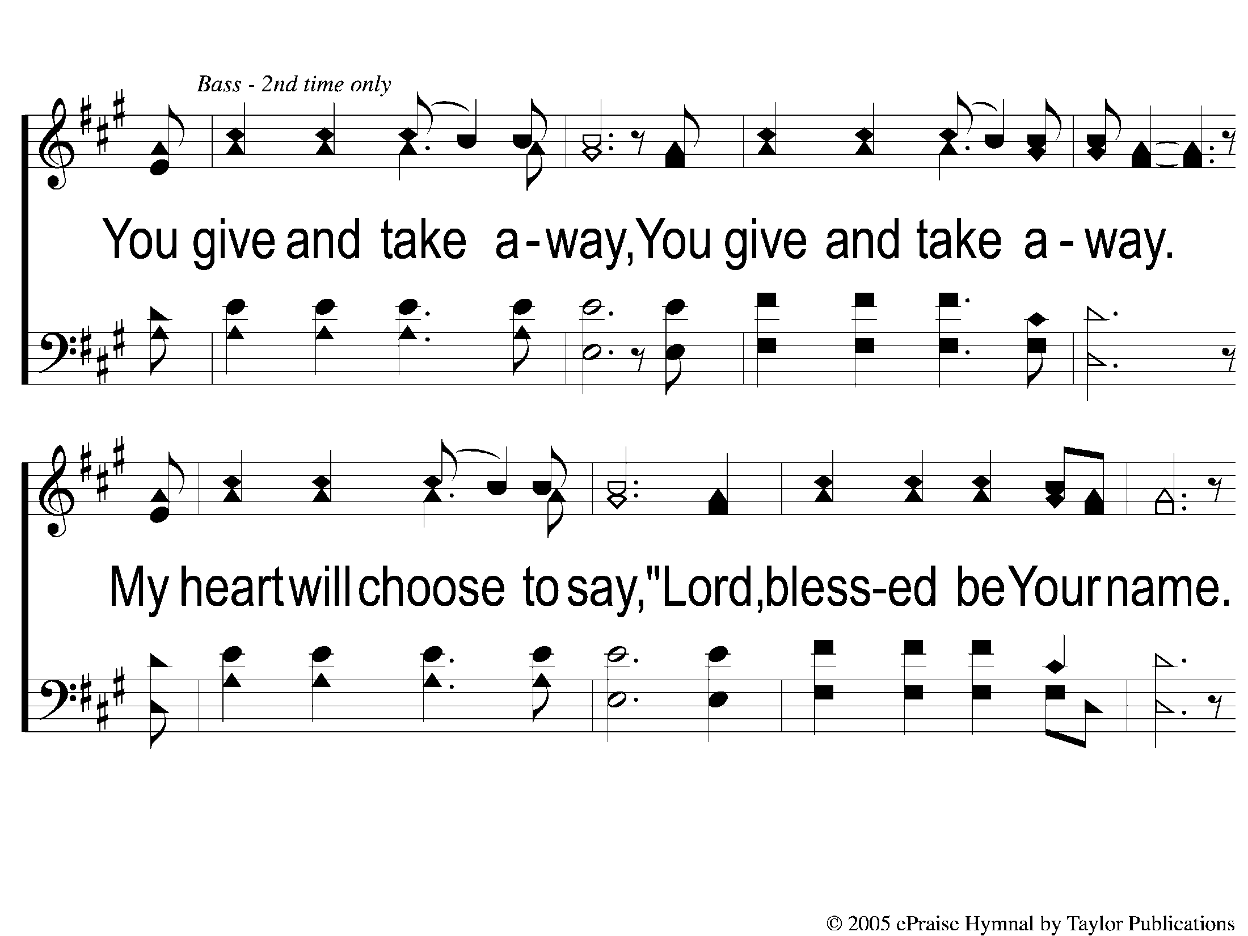
1Bridge2 Blessed Be Your Name
Blessed be Your Name

Slide 11
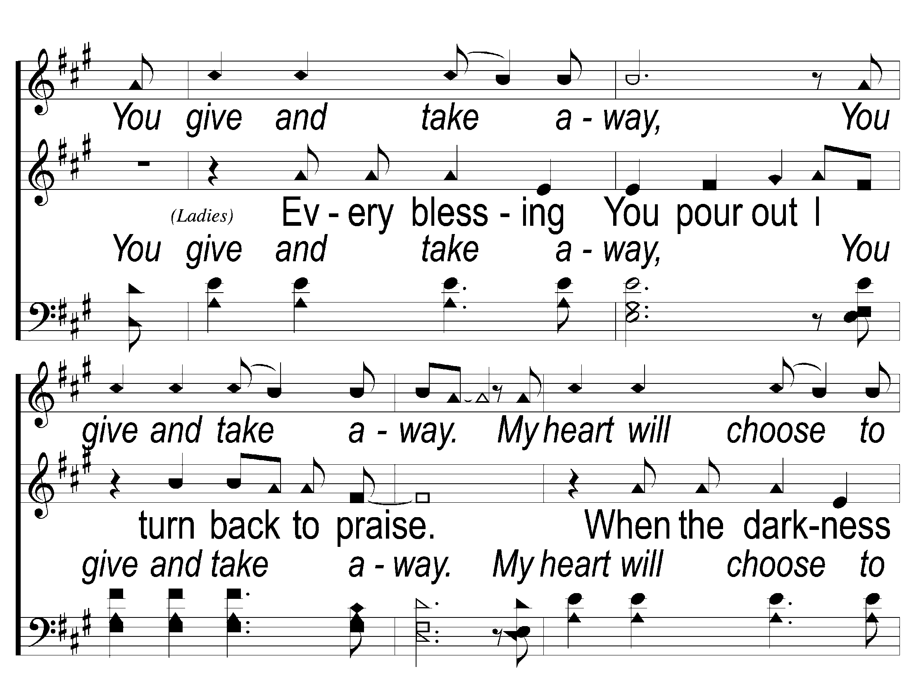
Bridge1 Blessed Be Your Name
Blessed be Your Name

Slide 12
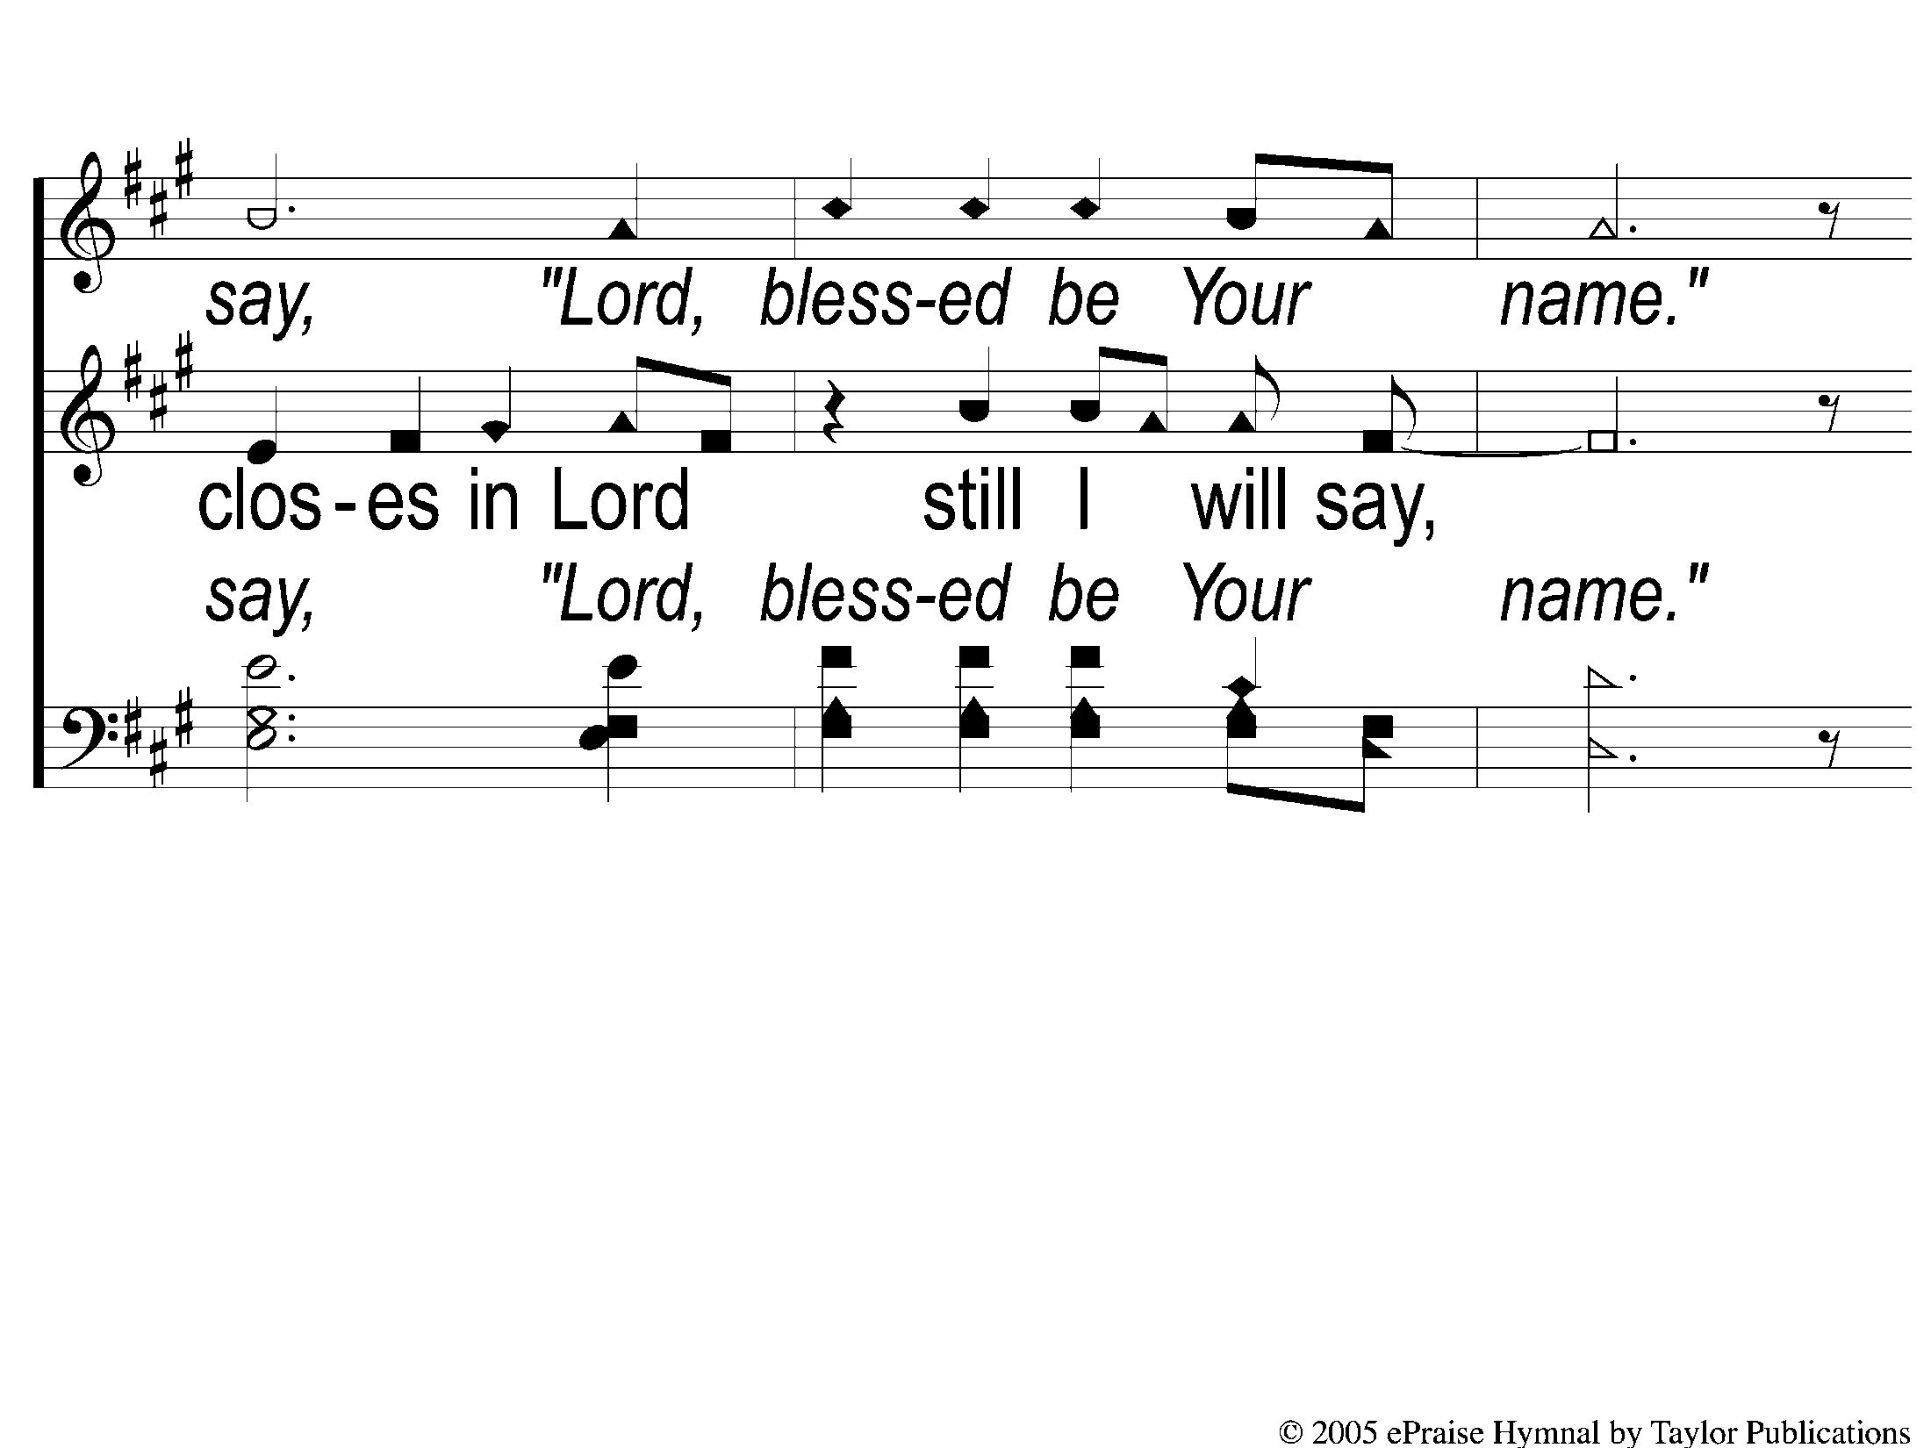
Bridge2 Blessed Be Your Name
Blessed be Your Name

Slide 13
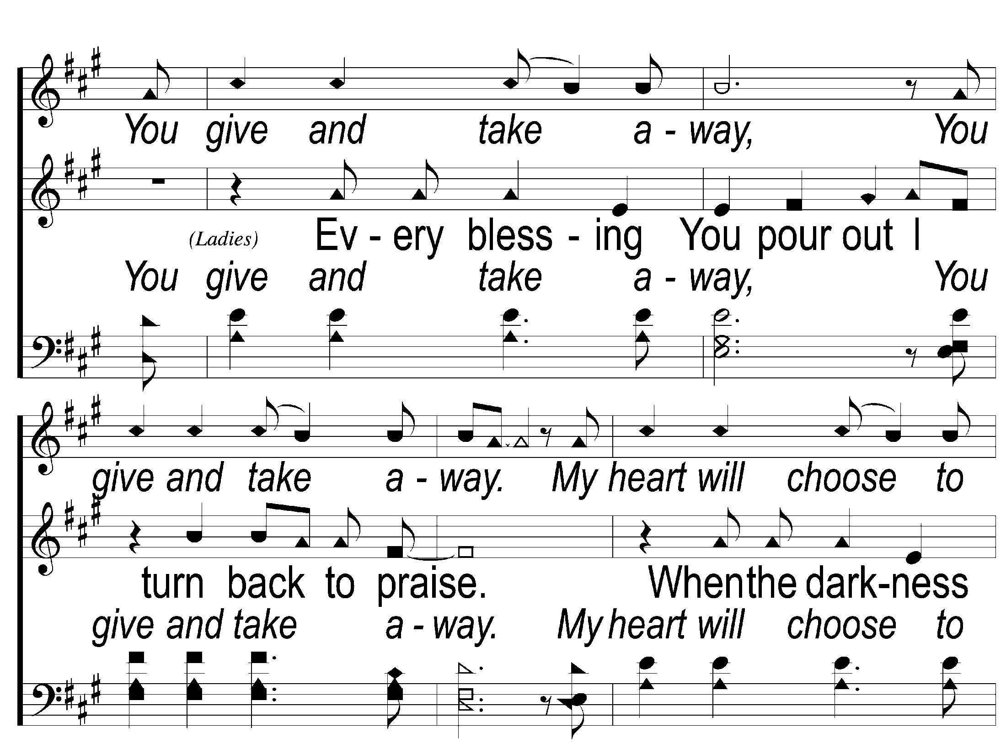
Bridge3 Blessed Be Your Name
Blessed be Your Name

Slide 14
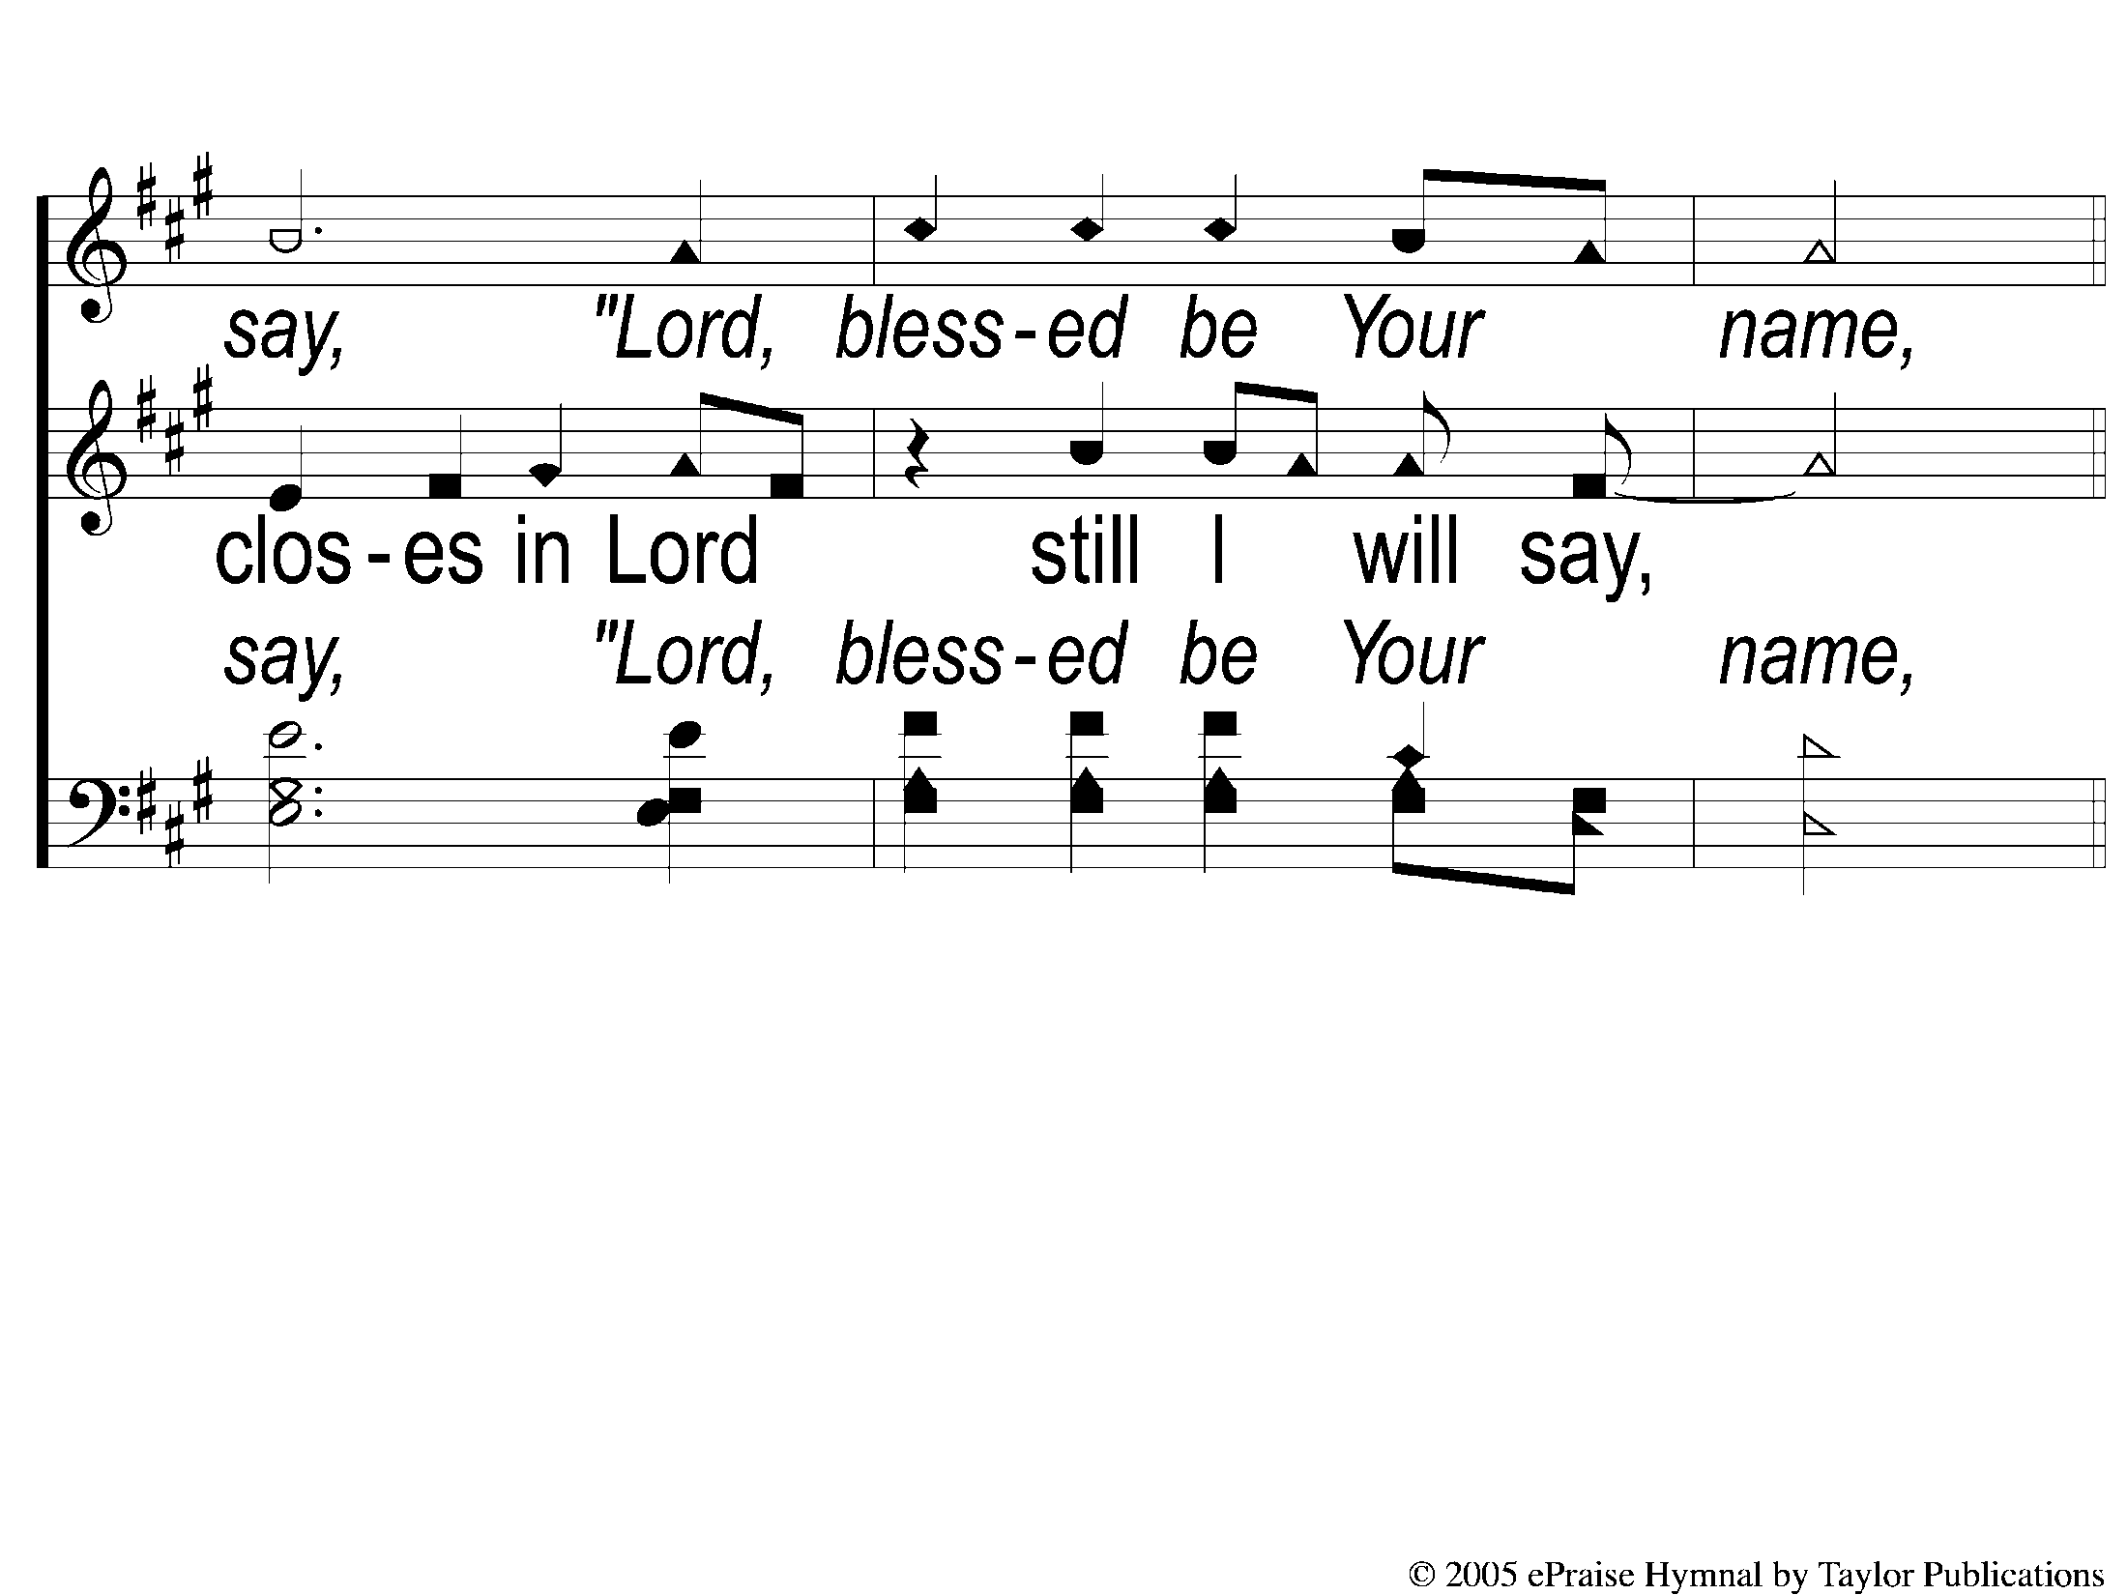
Bridge4 Blessed Be Your Name
Blessed be Your Name

Slide 15
Coda1 Blessed Be Your Name
Blessed be Your Name

Slide 16
Coda2 Blessed Be Your Name
Blessed be Your Name

Slide 17
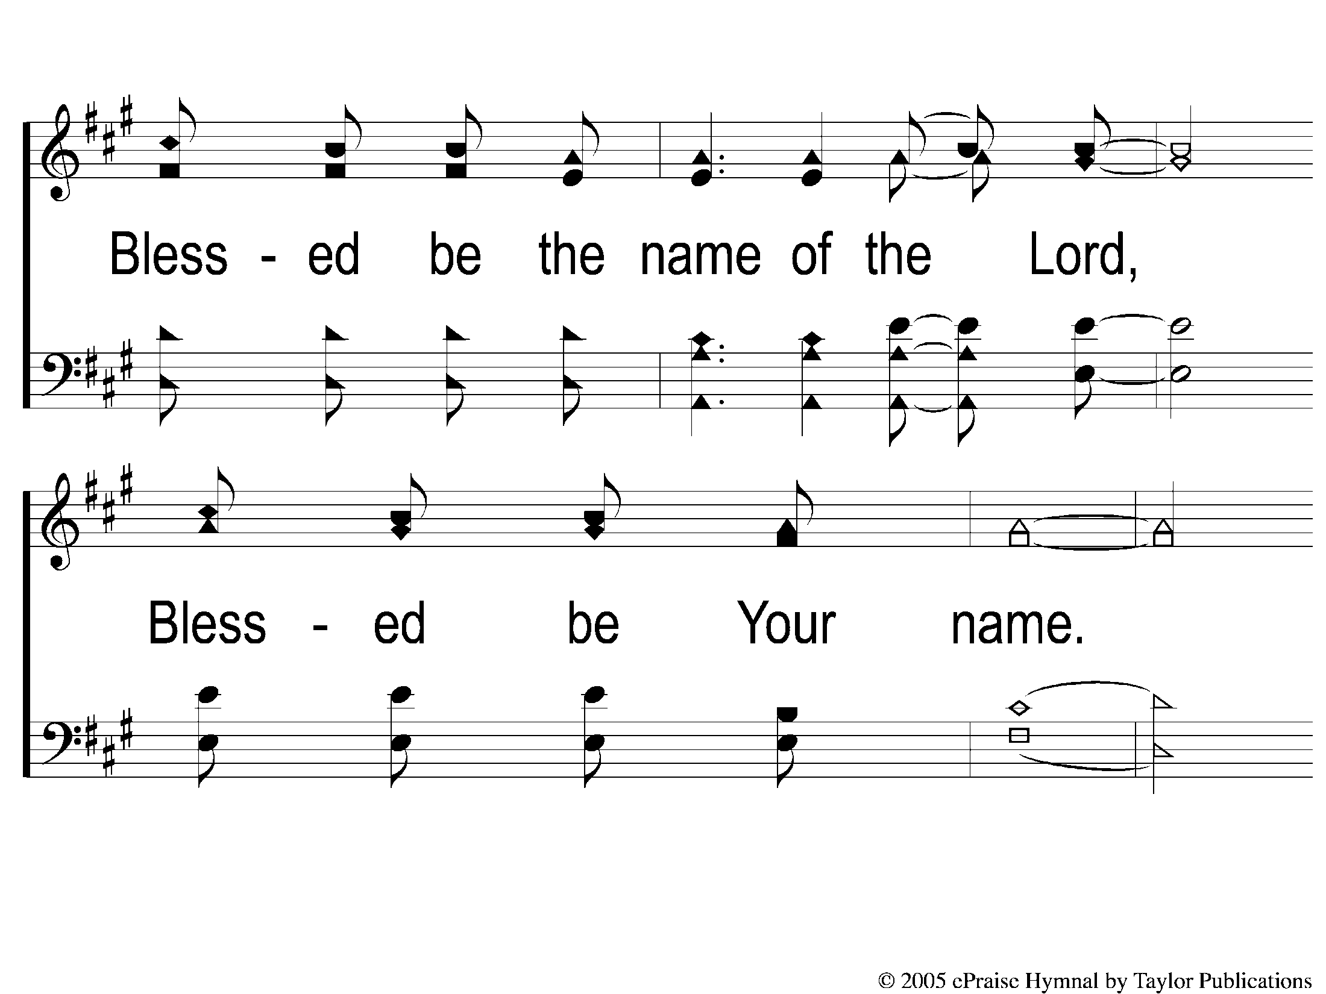
Coda3 Blessed Be Your Name
Blessed be Your Name

Slide 18
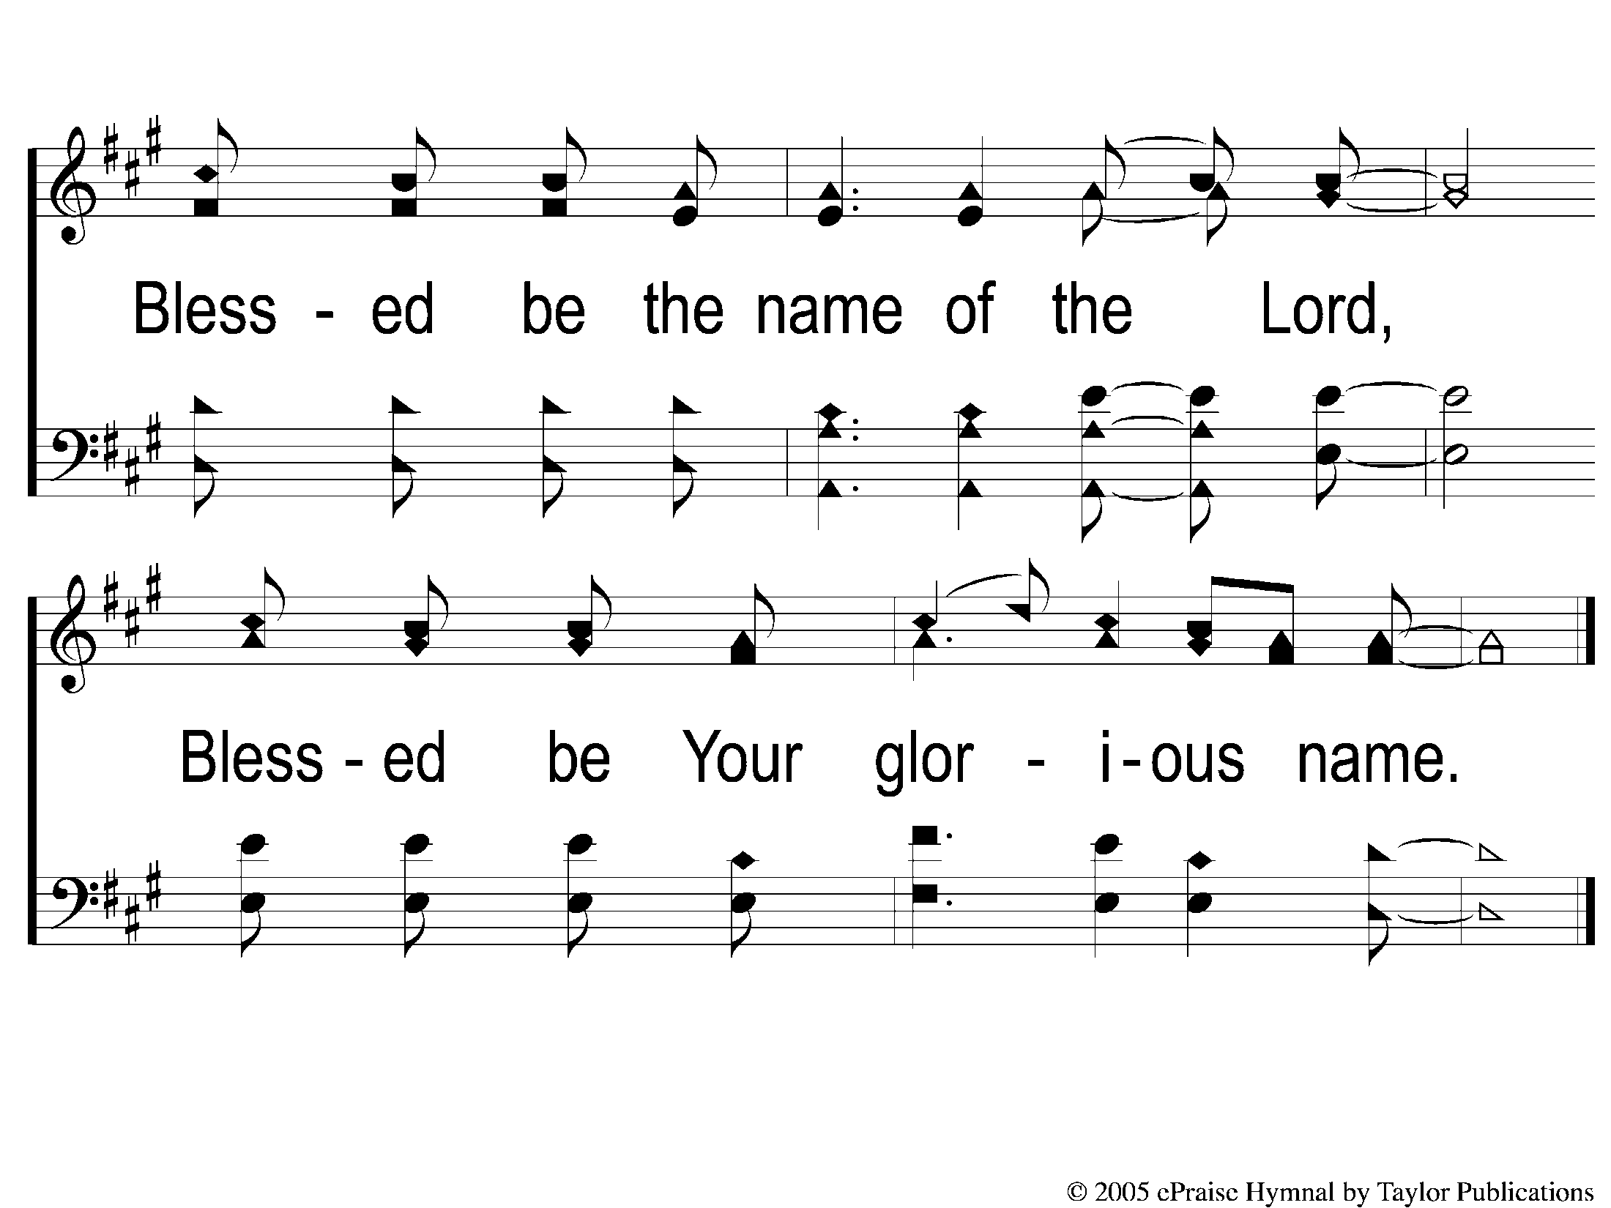
Coda4 Blessed Be Your Name
Blessed be Your Name

